Slide 1
REAL TIME SENTIMENT ANALYSIS OF US AIRLINE TWEETS
Prepared by:
Rohan Choksi

Slide 2
INTRODUCTION
twitter.com is a popular microblogging website.
Each tweet is 140 characters in length.
Tweets are frequently used to express a tweeter’s emotion on a particular subject.
The problem in sentimental analysis is classifying the polarity of a given text at the document, sentence or feature/aspect level.
Whether the expressed opinion in a document, a sentence or an entity feature /aspect is positive, negative or neutral.
Applications of text Mining are analyzing open-ended survey responses, automatic processing of messages, emails, etc

Slide 3

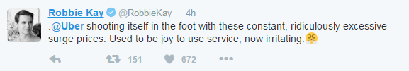

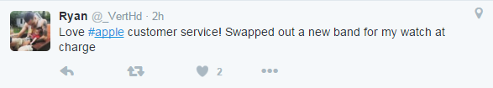

TWITTER IS USEFUL!
Politics
Marketing
Sentiment Analysis

Slide 4
OBJECTIVES
Focusing on customer views for 5 major airlines
Delta
American
JetBlue
Southwest
United
To implement an algorithm for automatic classification of text into positive, negative or neutral.
To extracts tweets in real time based upon user input and sentiments to derive using statistical modeling and rule-based natural language processing technique.
Graphical representation of the sentimental in form of pie-chart and histogram.

Slide 5
GAME PLAN
Load sentiment word lists
Search Twitter for airline mentions & collect tweet text
Score sentiment for each tweet
Summarize for each airline
Plot pie chart
Using summary table
Plot Score for each airline

Slide 6
CONNECTION BY USING TWITTER API AND SCANNING DICTIONARY
After creating Twitter API, following keys are needed to fetch live data from twitter
consumer_key ="your consumer key"
consumer_secret="your consumer secret"
access_token="your access token"
Access_token_secret="your access token secret“
Once connected, we can use searchTwitter() to find tweets with specific hashtags
delta.tweets = searchTwitter('@delta', n=500)
This will search delta tweets and number of tweets fetched will be 500.
After data is fetched we scan the positive and negative word dictionary, after that using score function we assign score to induvial airline.

Slide 7
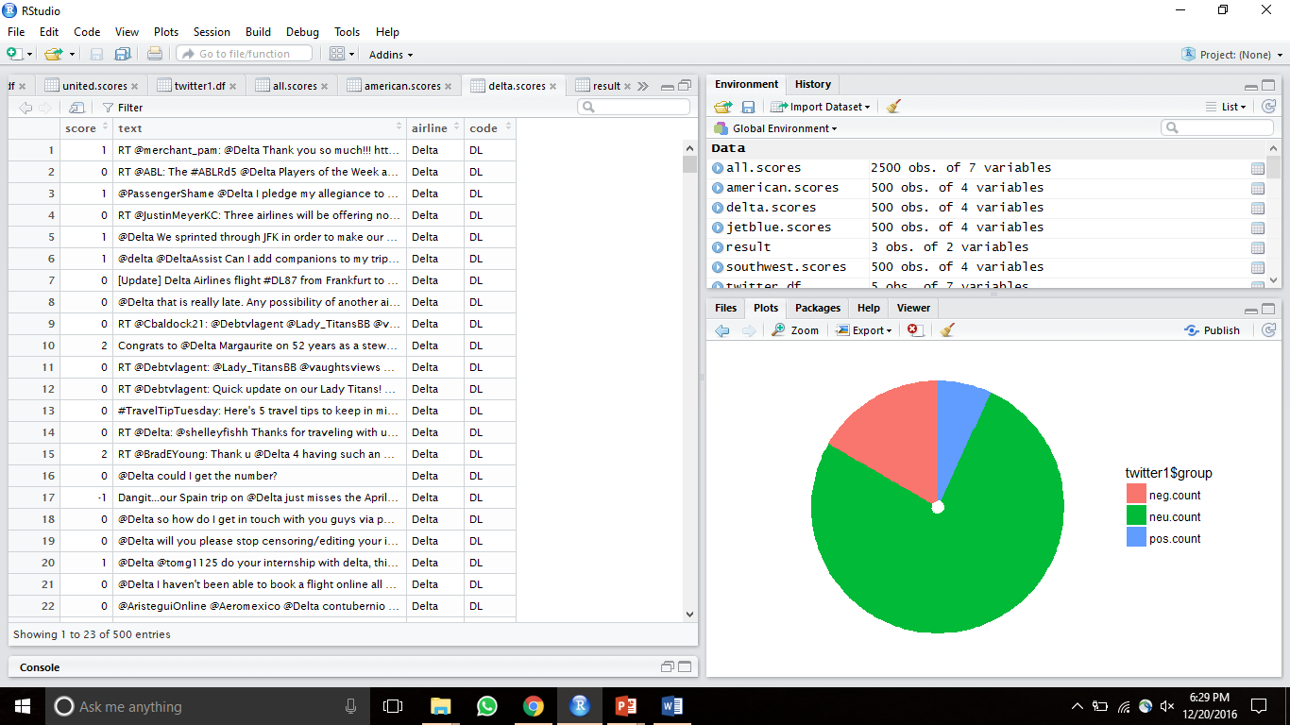
SANPSHOT OF SCORE ASSIGNED TO DELTA TWEETS

Slide 8
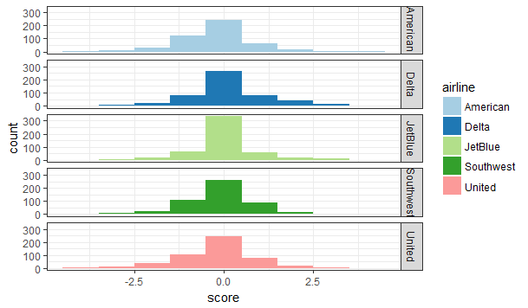
GRAPHICAL REPRESENTATION OF THE SENTIMENTS

Slide 9
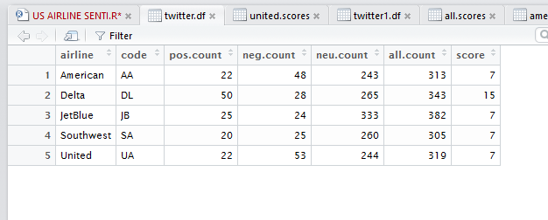
TOTAL SCORES OF ALL AIRLINES

Slide 10
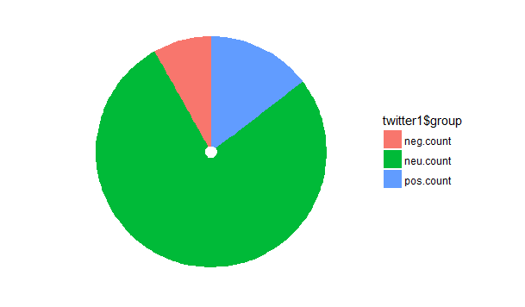
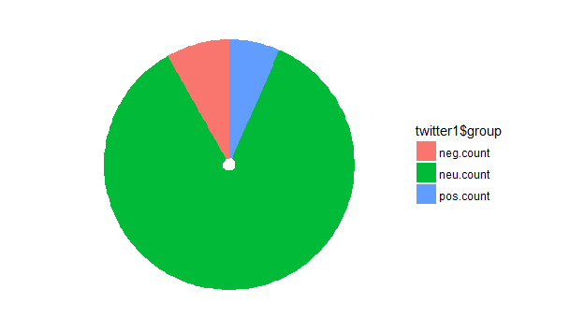
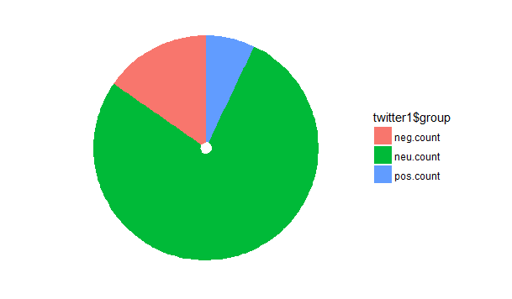
GRAPHICAL REPRESENTATION OF AIRLINES
American Airline
Southwest Airline
Delta Airline

Slide 11
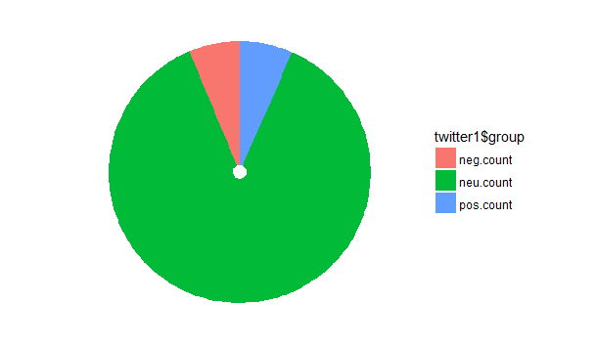
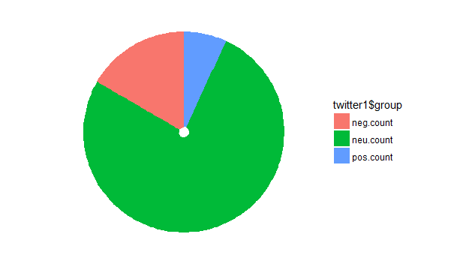
GRAPHICAL REPRESENTATION OF AIRLINES
JetBlue
United Airline

Slide 12
LIMITATIONS
There are certain limitations while doing Twitter Analysis using R. Firstly, while getting Status of user timeline the method can only return a fixed maximum number of tweets which is limited by the Twitter API.
While requesting tweets for a particular airline, it sometime happens that the number of retrieved tweets are less than the number of requested tweets.
While requesting tweets for a particular airline, the older tweets cannot be retrieved.

Slide 13
FUTURE SCOPE
We can use this real time twitter data, to plot highest number of positive, negative and neutral words used in the tweet, make a word cloud.
We can also consider the retweet factor to calculate score.
Furthermore, we can also find out the reasons for negative and positive review.
By performing above analysis company can know more about their customer and improve customer satisfaction and can provide them live data visualization of the positive negative or neutral comments of the customer geographically.

Slide 14
CONCLUSION
We found out scores for all the major airlines based on first 500 tweets for each airline.
We can conclude that majority of the tweets were neutral.
The sequence of the neutral sentiment for airlines are as follows(1st has highest neutral tweets)
JetBlue
Delta
Southwest
United
Tweets related to Delta were more positive compared to other airlines.
Tweets related to United were more negative compared to other airlines.

Slide 15
THANK YOU!

